Slide 1



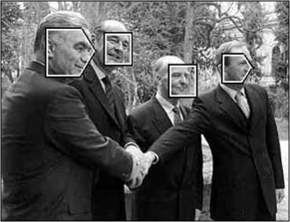
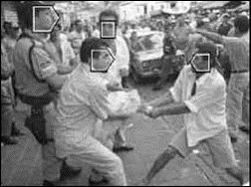
Viola-Jones Face Detection algorithm
Professor:
Presented by:
EL OIRRAK Ahmed
Khadija Bouzzite
Mohamed Ouballa
Notes:
khadija
slide [1,14] [30,32]
hajja slides [15,30]
hassan code

Slide 2

02
Introduction?
Plane
What are Haar-like features?
What is an Integral Image?
Haar like features with Integral Image
AdaBoost
Cascade filter
Practical Implementation and Evaluation

Slide 3
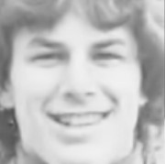
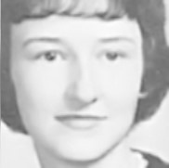
Face detection using Viola Jones algorithm
Face detection is an image processing technique used in computer vision to detect a face in digital images.
Viola-Jones is a real-time object detection and can be trained to detect a variety of object classes,it was motivated primarily by the problem of face detection.
what is the problem?
The problem to be solved is the detection of faces in an image. A human can do this easily, but a computer needs precise instructions and constraints. To make the task more manageable, Viola-Jones requires full view frontal upright faces. Thus in order to be detected, the entire face must point towards the camera and should not be tilted to either side. While it seems these constraints could diminish the algorithm's utility somewhat, because the detection step is most often followed by a recognition step, in practice these limits on pose are quite acceptable.
03

Slide 4
The Viola-Jones algorithm main steps
04
Selecting Haar-like features
Creating an integral image
Running AdaBoost training
Creating classifier cascades

Slide 5
05
Haar-like features

Slide 6
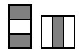
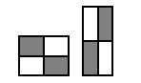
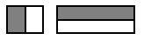
What are Haar-Like Features?
Haar-like features are digital image features used in object recognition. All human faces share some universal properties of the human face like the eyes region is darker than its neighbour pixels, and the nose region is brighter than the eye region.
A simple way to find out which region is lighter or darker is to sum up the pixel values of both regions and compare them.
There are 3 types of Haar-like features that Viola and Jones identified in their research:
Edge features
Line-features
Four-sided features
06

Slide 7
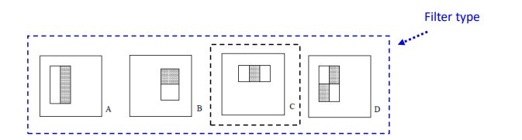
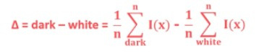
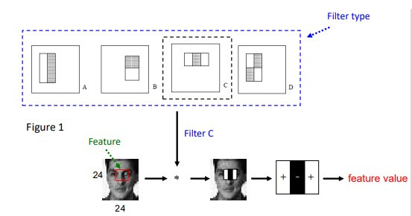
These features can be difficult to determine for a large image. This is where integral images come into play because the number of operations is reduced using the integral image.
07

Slide 8
08
Integral Image

Slide 9
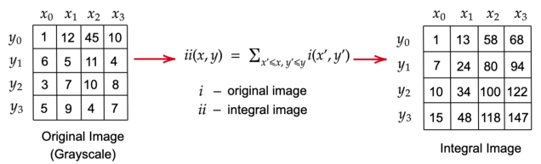
Creating Integral Images
An Integral Image is an intermediate representation of an image where the value for location (x, y) on the integral image equals the sum of the pixels above and to the left (inclusive) of the (x, y) location on the original image
Y
09

Slide 10
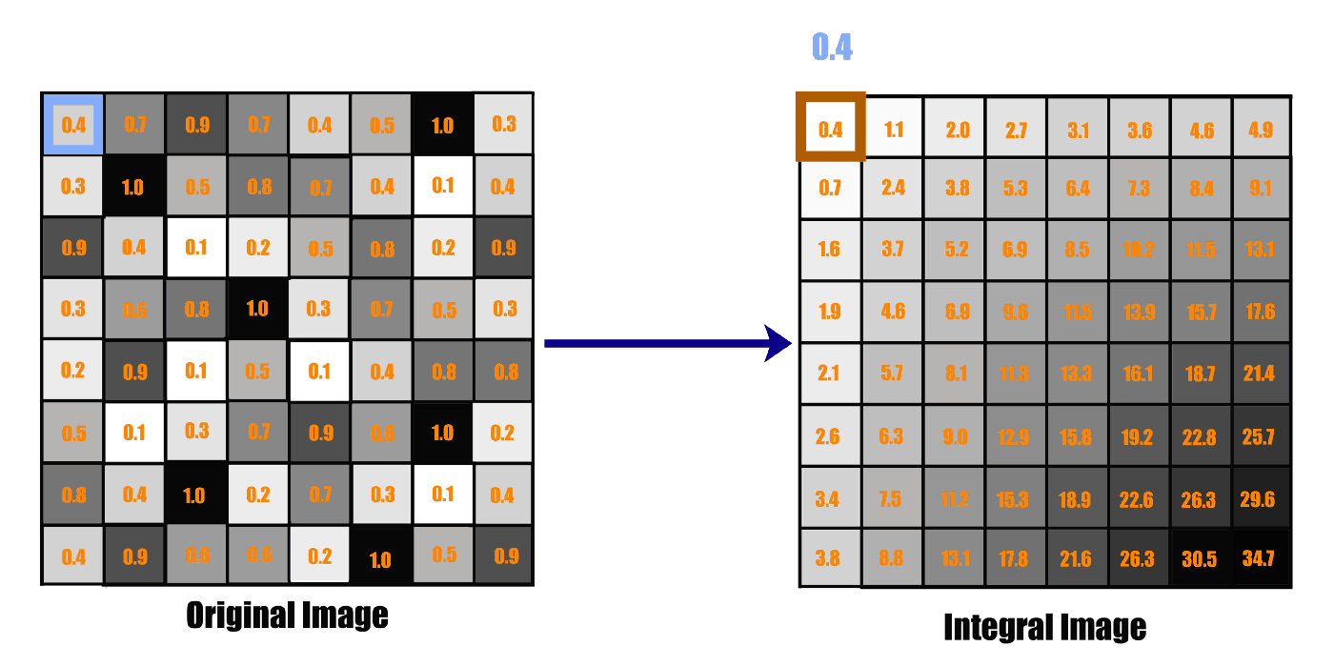
integral images essentially speed up the calculation of these Haar features. Instead of computing at every pixel, it instead creates sub-rectangles and creates array references for each of those sub-rectangles.
These are then used to compute the Haar features.
10

Slide 11
11
Haar like features with Integral Image

Slide 12
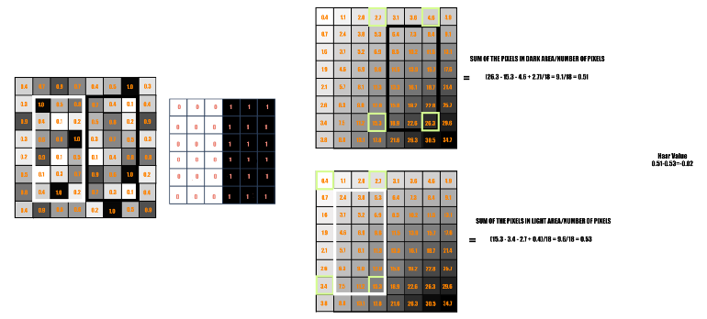
Haar like features with Integral Image
12

Slide 13
13
Adaboost Training

Slide 14
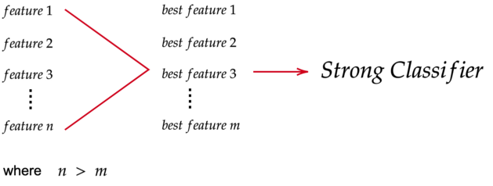
Adaptive Boosting
The AdaBoost Algorithm is a machine learning algorithm for selecting the best subset of features among all available features
The output of the algorithm is a classifier (a.k.a Prediction Function, Hypothesis Function) called a "Strong Classifier"
A Strong Classifier is made up of a linear combinations of “Weak Classifiers” (best features).
In each iteration, the algorithm finds the error rate for all features and then choose the feature with the lowest error rate for that iteration.
14

Slide 15
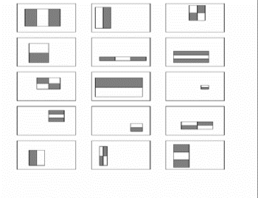
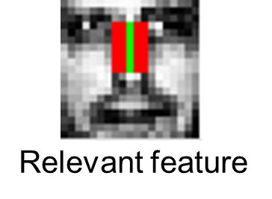
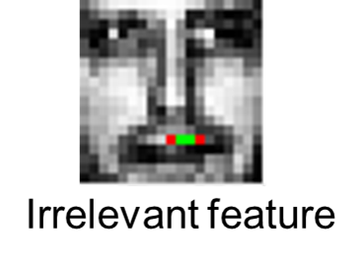
Adaptive Boosting
15

Slide 16
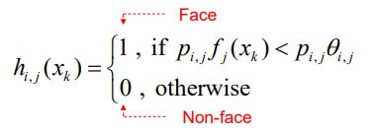
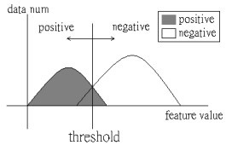
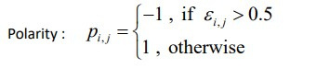
Adaptive Boosting
after computing all feature values,we need to define a weak classifier
16

Slide 17
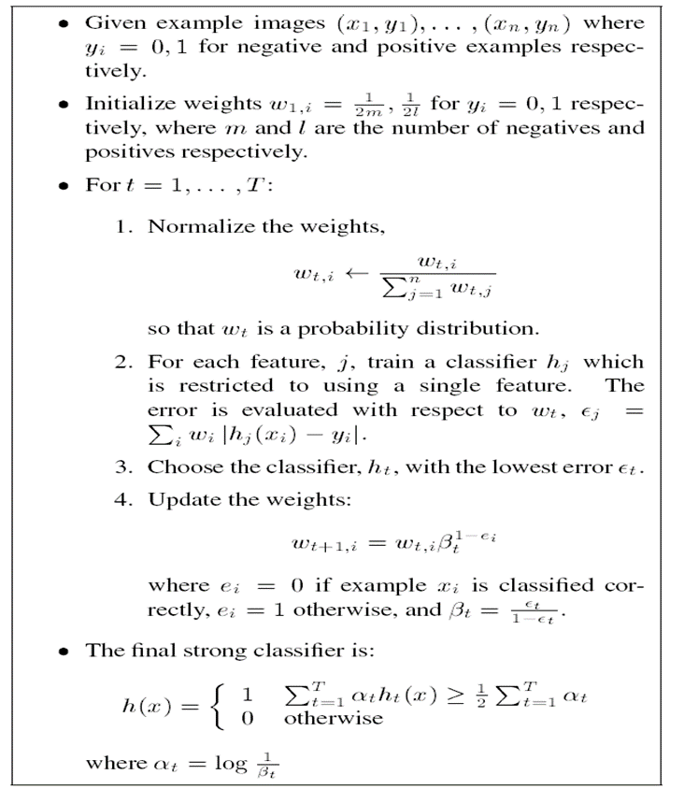
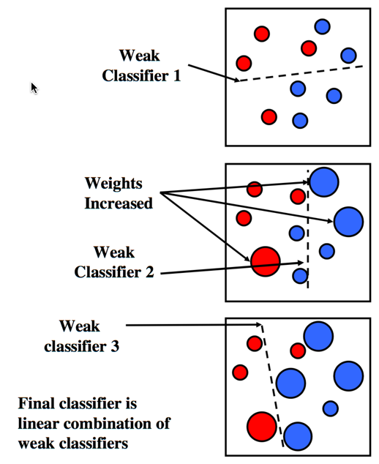
AdaBoost Algorithm
Start with uniform weights on training examples
For T rounds
Evaluate weighted error for each feature, pick best.
Re-weight the examples:
Incorrectly classified -> more weight
Correctly classified -> less weight
Final classifier is combination of the weak ones, weighted according to error they had.
17

Slide 18
18
Cascade Classifier

Slide 19
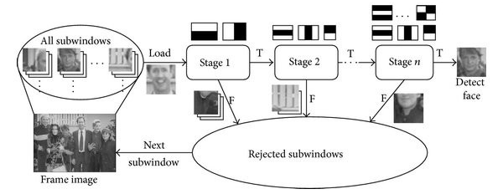
Cascade Classifier
A Cascade Classifier is a multi-stage classifier that can perform detection quickly and accurately.
Each stage consists of a strong classifier produced by the AdaBoost Algorithm. From one stage to another, the number of weak classifiers in a strong classifier increases.
An input is evaluated on a sequential (stage by stage) basis. If a classifier for a specific stage outputs a negative result, the input is discarded immediately
In case the output is positive, the input is forwarded on to the next stage
19

Slide 20
20
Practical Implementation
and Evaluation

